Slide 2
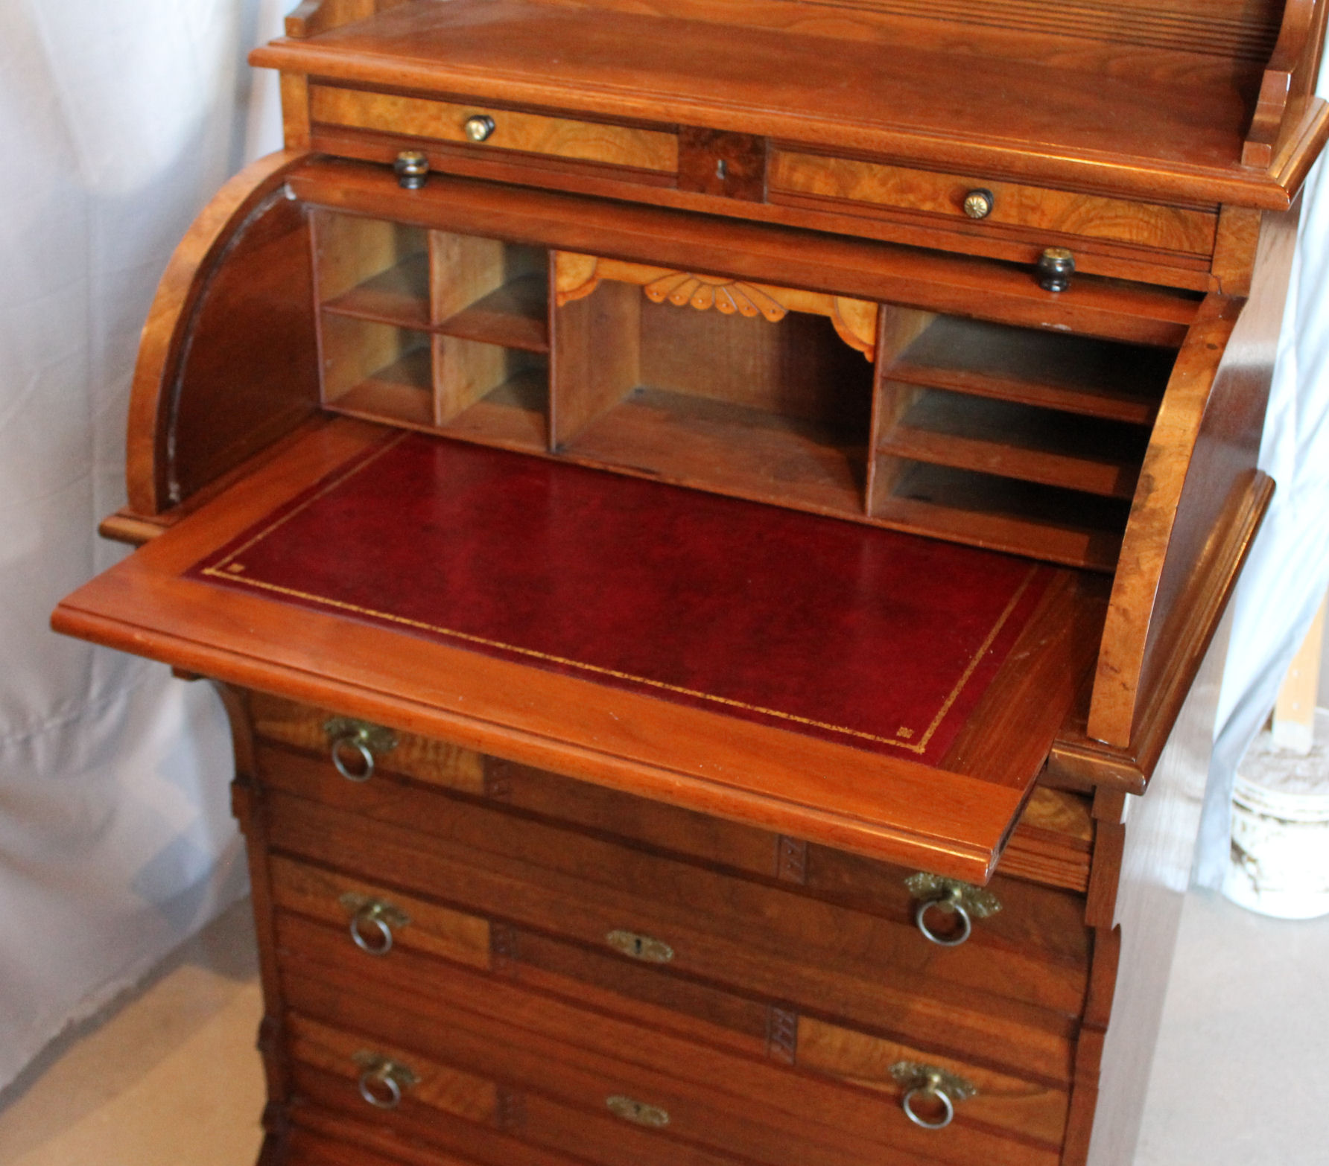
Letters Here & Abroad

Slide 3
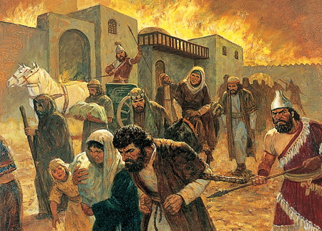

Slide 4
Now these are the words of the letter which Jeremiah the prophet sent from Jerusalem to the rest of the elders of the exile, the prophets, and all the people whom Nebuchadnezzar had taken into exile from Jerusalem to Babylon.

Slide 5
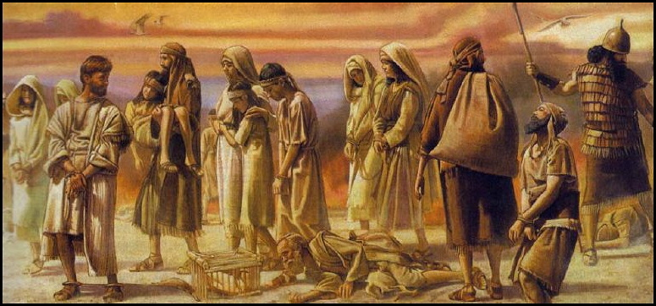
Psalms 137:1-6
How were they to act in Babylon?
Were they to wait for a chance to break free?
Were they to overthrow the government?

Slide 6
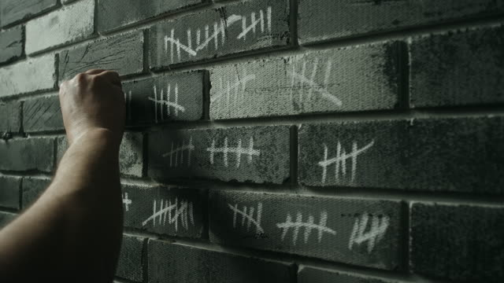
Were they to simply count the days like a prisoner?

Slide 7
Jeremiah 29:4-14
The Balance Between Here & There

Slide 8
God Expected His People to be a Blessing in Babylon
By making improvements (5)
By making a good impression (7)
By making a future (6)

Slide 9
God expected them not to forget His promise
Home was Jerusalem (11)

Slide 10
Heaven is our home
The Balance Between Here & There
How are we to act in this land?

Slide 11
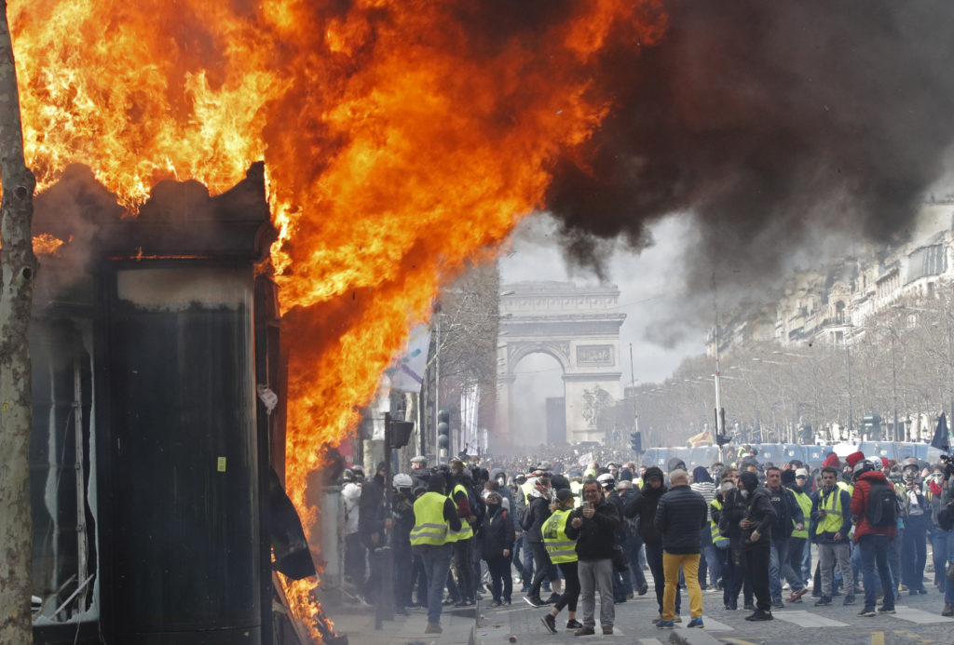
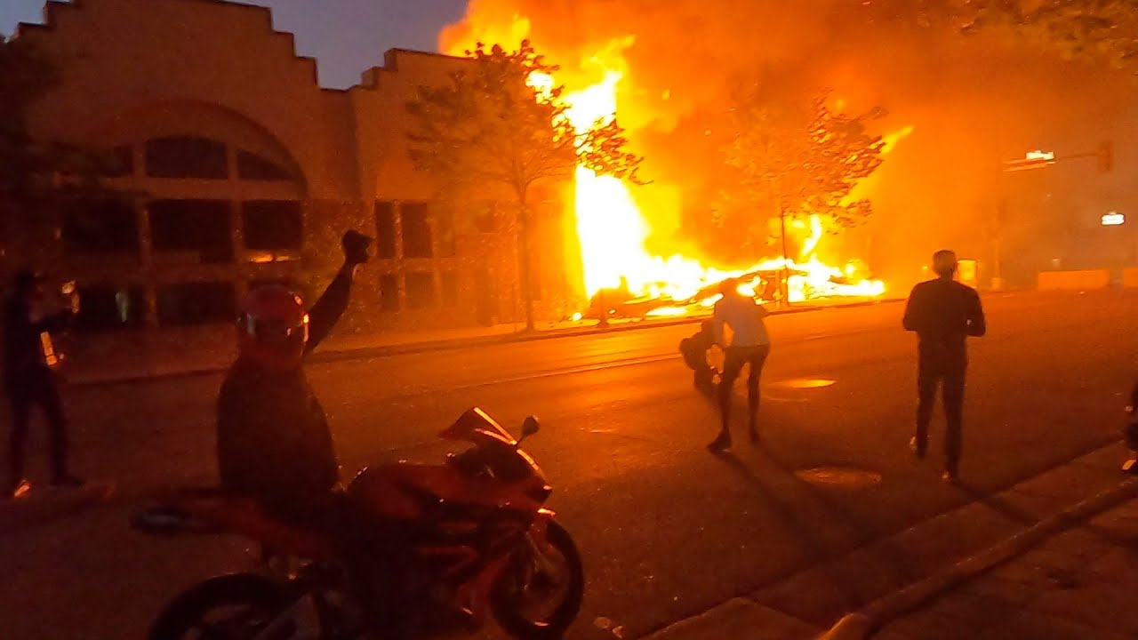
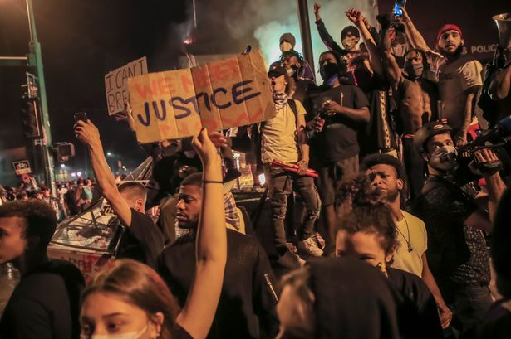
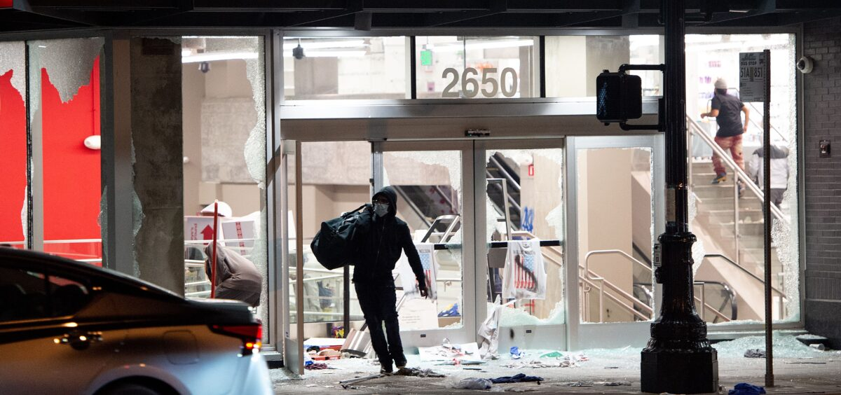
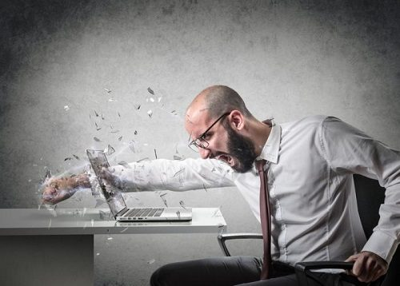

Slide 12
While we are here, we are to be a blessing
We must make improvements

Slide 13
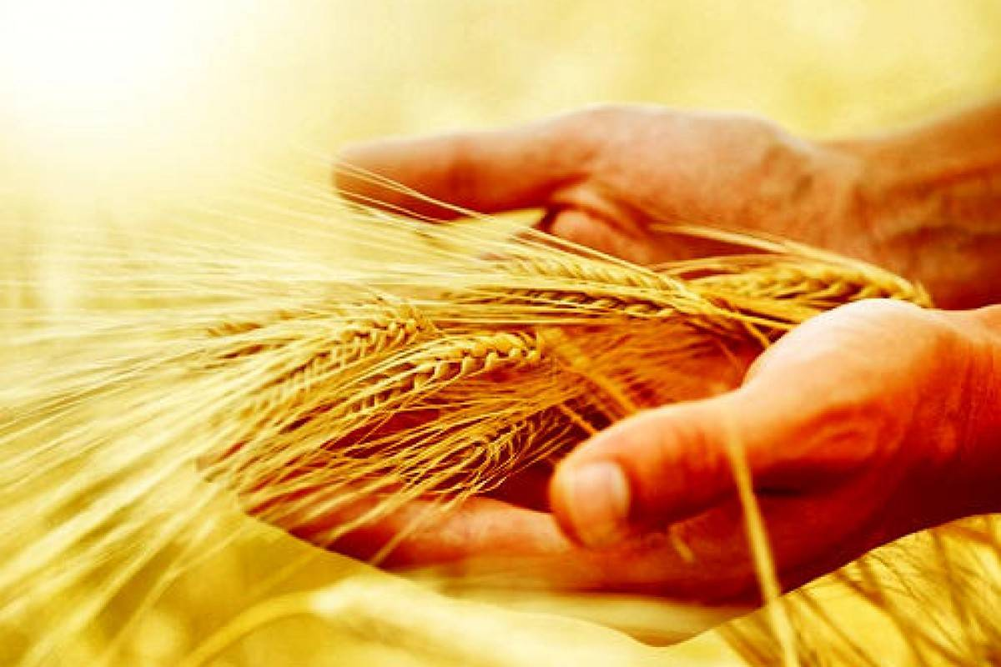
By being good stewards of what God has blessed us with
Psalms 24:1 “The earth is the Lord’s, and all it contains, the world and those who dwell in in.”
Psalms 50:10 “For every animal of the forest is Mine, the cattle on a thousand hills.”
Psalms 50:11 “I know every bird of the mountains, and everything that moves in the field is Mine.”

Slide 14
By Being Better Examples To Others
Of Obedient Citizens
Romans 13:1-2 “Let every person be in subjection to the governing authorities. For there is no authority except from God, and those which exist are established by God. Therefore he who resists authority has opposed the ordinance of God; and they who have opposed will receive condemnation upon themselves.”

Slide 15
By Being Better Examples To Others
Of Honest Worker
Colossians 3:23-24 “ Whatever you do, do your work heartily, as for the Lord and not for people, knowing that it is from the Lord that you will receive the reward of the inheritance. It is the Lord Christ whom you serve.

Slide 16
By Being Better Examples To Others
Of Praying for Leaders
1 Timothy 2:1-2 “First of all, then, I urge that requests, prayers, intercession, and thanksgiving be made in behalf of all people, for kings and all who are in authority, so that we may lead a tranquil and quiet life in all godliness and dignity.

Slide 17
By Being Better Examples To Others
Of Walking in integrity with others
Titus 3:2-7

Slide 18
By Being Better Examples To Others
Of Showing the heart of Jesus
Philippians 2:15 “so that you will prove yourselves to be blameless and innocent, children of God above reproach in the midst of a crooked and perverse generation, among whom you appear as lights in the world”

Slide 19
By Being Better Examples To Others
Of Raising Godly Families
Ephesians 6:4 “Fathers, do not provoke your children to anger, but bring them up in the discipline and instruction of the Lord.”

Slide 20
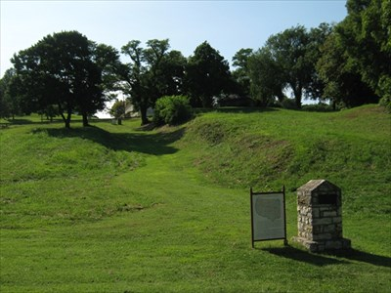

Slide 21
While here we never lose sight of that heavenly home
It is reflected in the way we treat others
It is demonstrated in how we care for others
It is shown in our desire to bring others to Christ

Slide 22
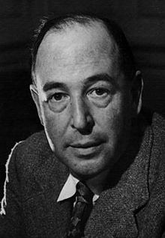
“If you read history you will find that the Christians who did the most for the present world were precisely those who thought the most of the next world. It is when Christians have largely ceased to think of the other world that they have become ineffective in this world.”
C.S. Lewis

Slide 23
The Balance Between Here & There
To be so concerned about earth that we miss Heaven makes us become conformed to this world

Slide 24
The Balance Between Here & There
To be so heavenly focused that we don’t care about others is to miss the purpose of Jesus
Some people are so heavenly focused that they’re no earthly good

Slide 25
The Balance Between Here & There
We are to be a blessing here while we long for that Heavenly Home…
We live as if we have one foot already in Heaven

