Slide 2
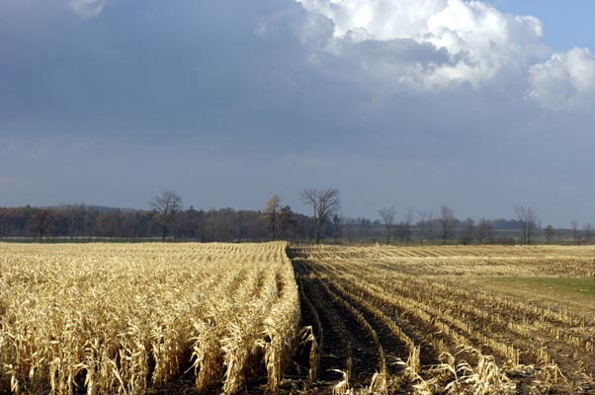
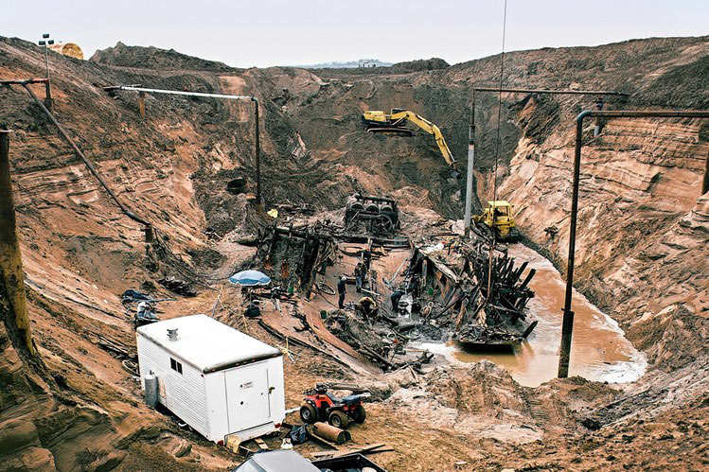
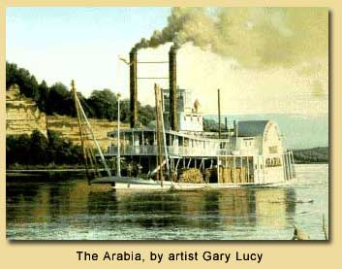
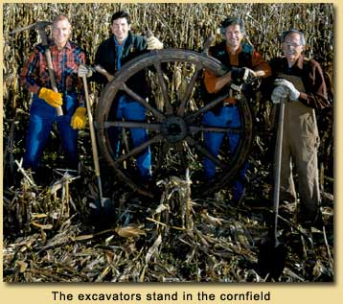

Slide 3
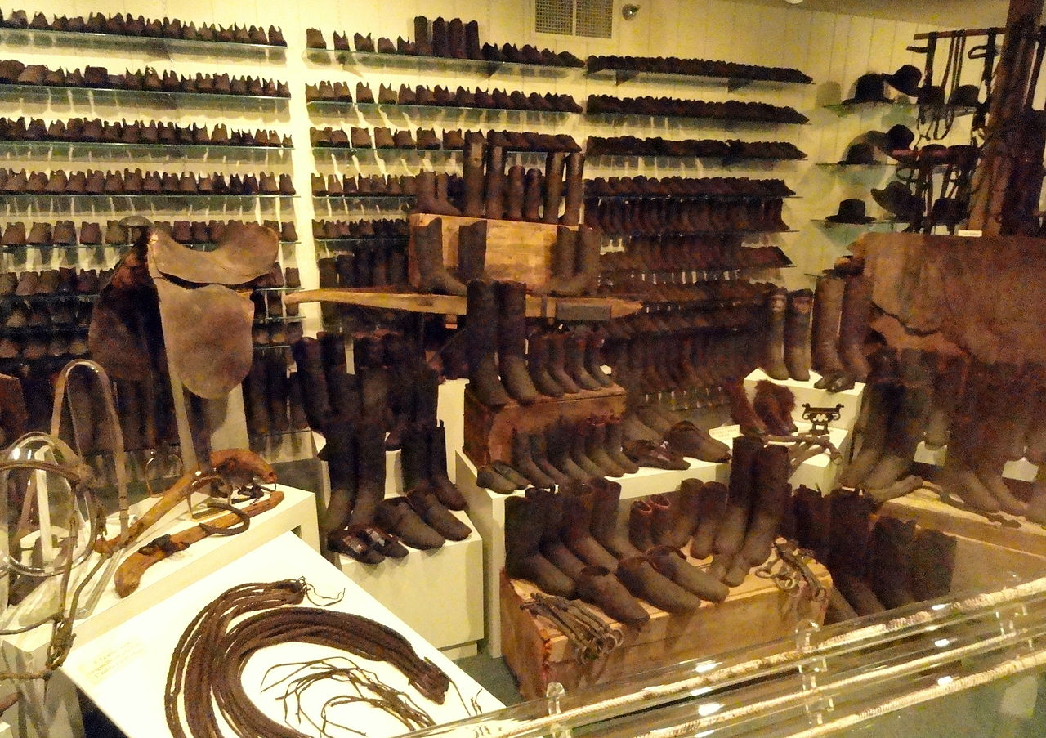
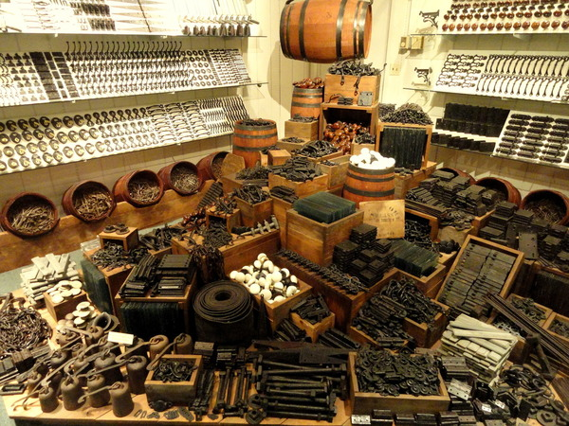

Slide 4
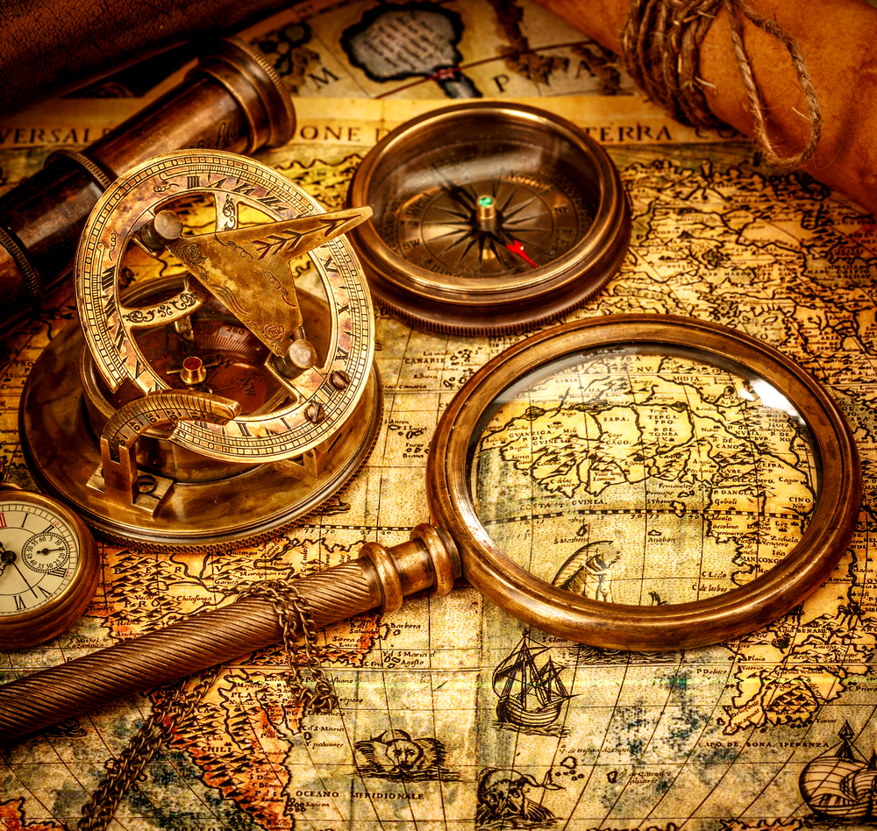
The Discovery of Real Treasure

Slide 5
Matthew 13
A series of comparisons to illustrate the Kingdom of Heaven

Slide 6
It is a kingdom of Salvation
John 18:36 “Jesus answered, “My kingdom is not of this world. If My kingdom were of this world, My servants would be fighting so that I would not be handed over to the Jews; but as it is, My kingdom is not of this realm.”

Slide 7
It is a kingdom of Salvation
Daniel 2:44 “And in the days of those kings the God of heaven will set up a kingdom which will never be destroyed, and that kingdom will not be left for another people; it will crush and put an end to all these kingdoms, but it will itself endure forever.”

Slide 8
Matthew 13:44-46 “The kingdom of heaven is like a treasure hidden in the field, which a man found and hid again; and from joy over it he goes and sells everything that he has, and buys that field. Again the kingdom of heaven is like a merchant seeking fine pearls, and upon finding one pearl of great value, he went and sold everything that he had and bought it.”
Both men recognized the incredible value of the treasure

Slide 9
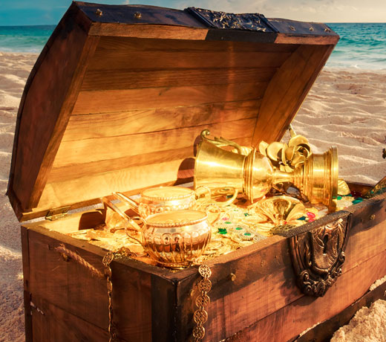
What was the treasure?
Salvation in Christ
Revelation 1:5 “and from Jesus Christ, the faithful witness, the firstborn of the dead, and the ruler of the kings of the earth. To Him who loves us and released us from our sins by His blood”

Slide 10
What was the treasure?
Salvation in Christ
Jesus can redeem your past
Jesus can change your present
Jesus can give you hope for tomorrow

Slide 11
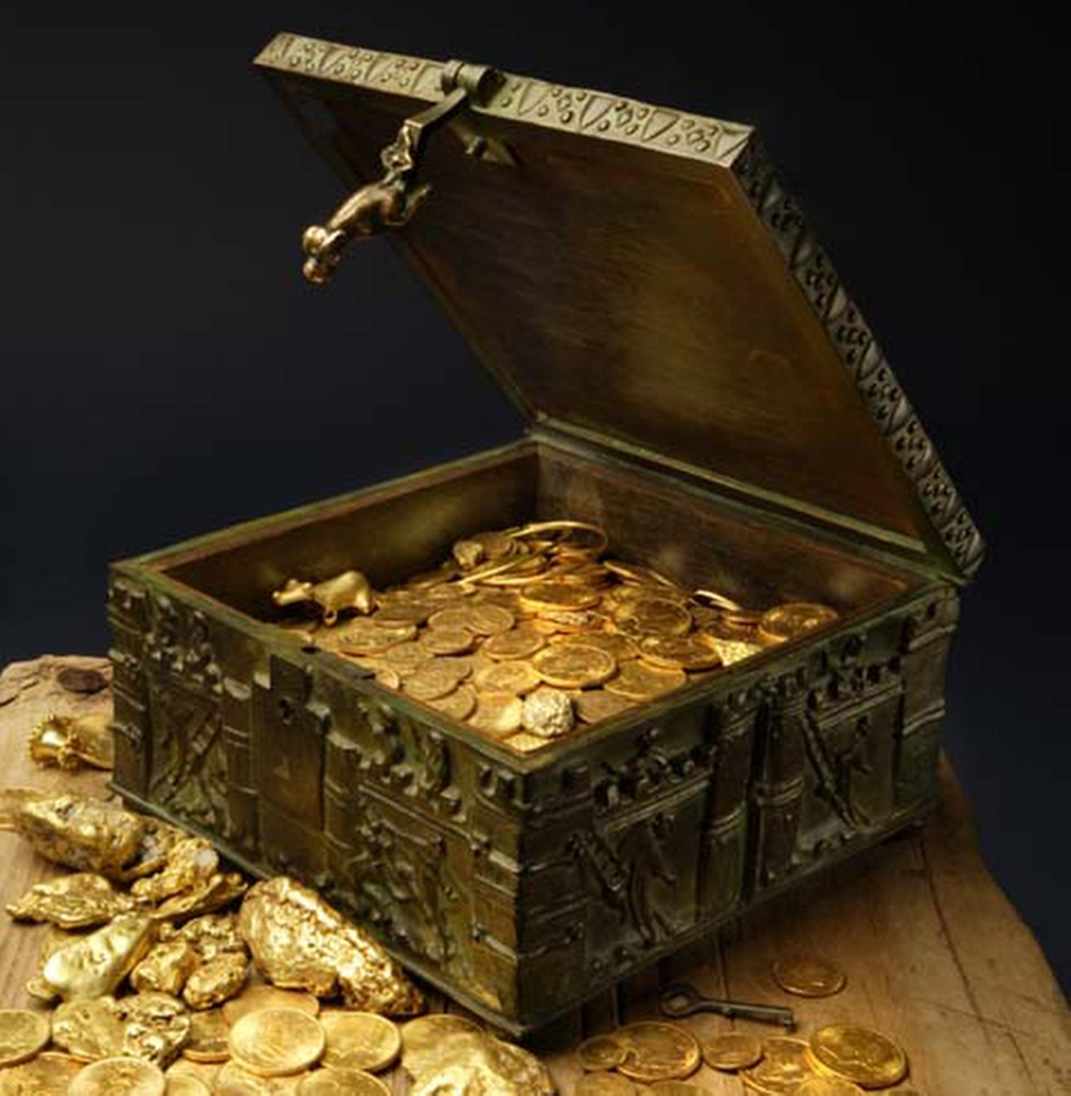
No one had to tell them…
Some discover tis too late

Slide 12
1. How much it cost to make
2. How rare something is
3. What it means to you
How is value determined?

Slide 13
Matthew 13:44-46 “The kingdom of heaven is like a treasure hidden in the field, which a man found and hid again; and from joy over it he goes and sells everything that he has, and buys that field. Again the kingdom of heaven is like a merchant seeking fine pearls, and upon finding one pearl of great value, he went and sold everything that he had and bought it.”
2. Both wanted this treasure

Slide 14
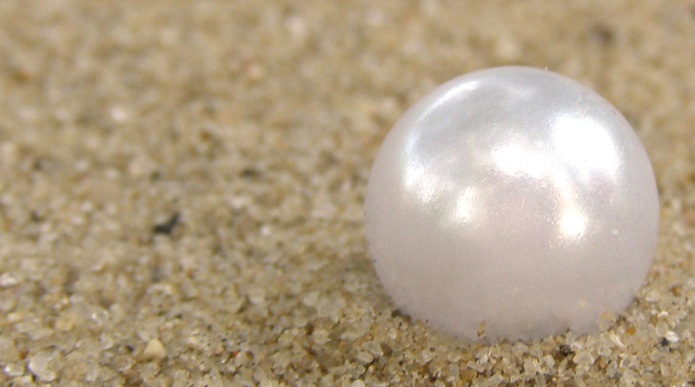
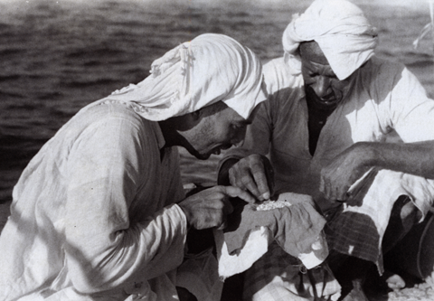
The Pearl Merchant
He was looking
He knew pearls

Slide 15
Colossians 3:4 When Christ, who is our life, is revealed, then you also will be revealed with Him in glory.
Hope
Direction
Found in Christ
Purpose
Eternity

Slide 16
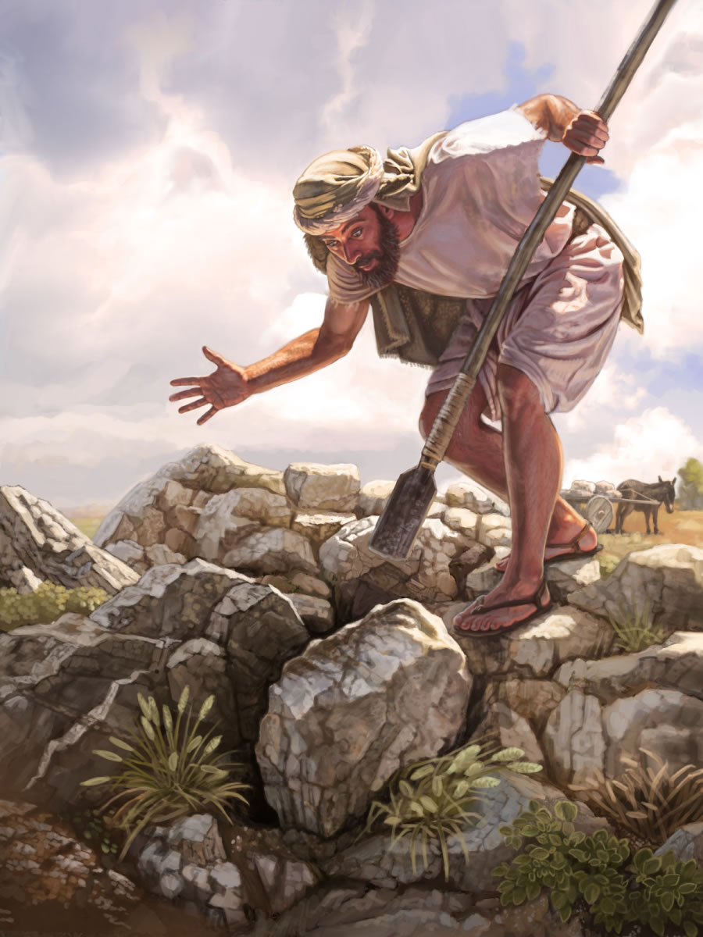
The First Man
He is not looking
He stumbles upon a great treasure

Slide 17
What happed if I died tonight?
What about Jesus?

Slide 18
Two Men – Two Treasures
Both men sold all they had
They both really wanted what they found
They both were willing to pay the ultimate cost

Slide 19
Marriage
Your children in Heaven
Your Salvation

Slide 20
The Discovery of Real Treasure

