Slide 2
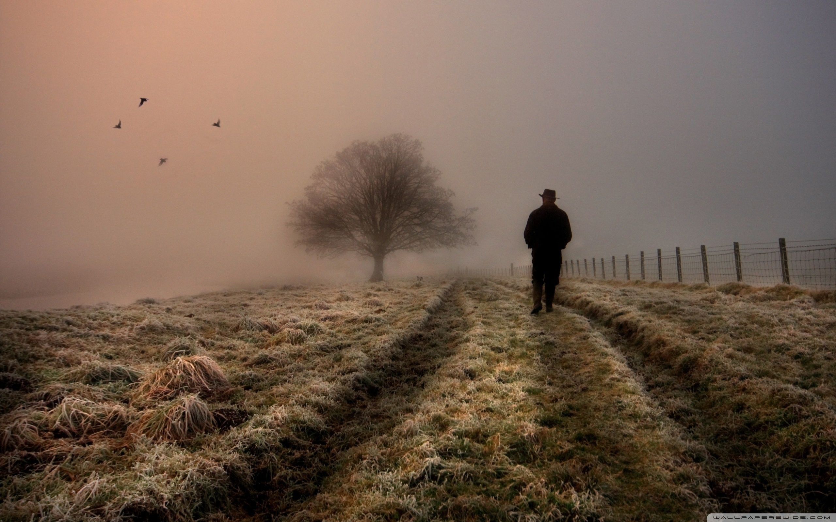

Slide 3
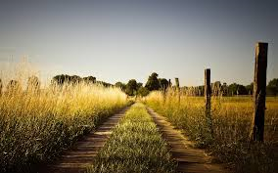
The Journey from Knowing to Believing
Luke 24:13-33

Slide 4
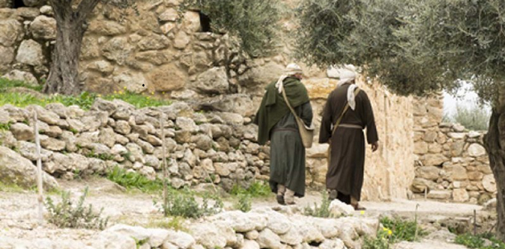
Disappointed…Discouraged
Luke 24:17b “And they stood still, looking sad.”

Slide 5
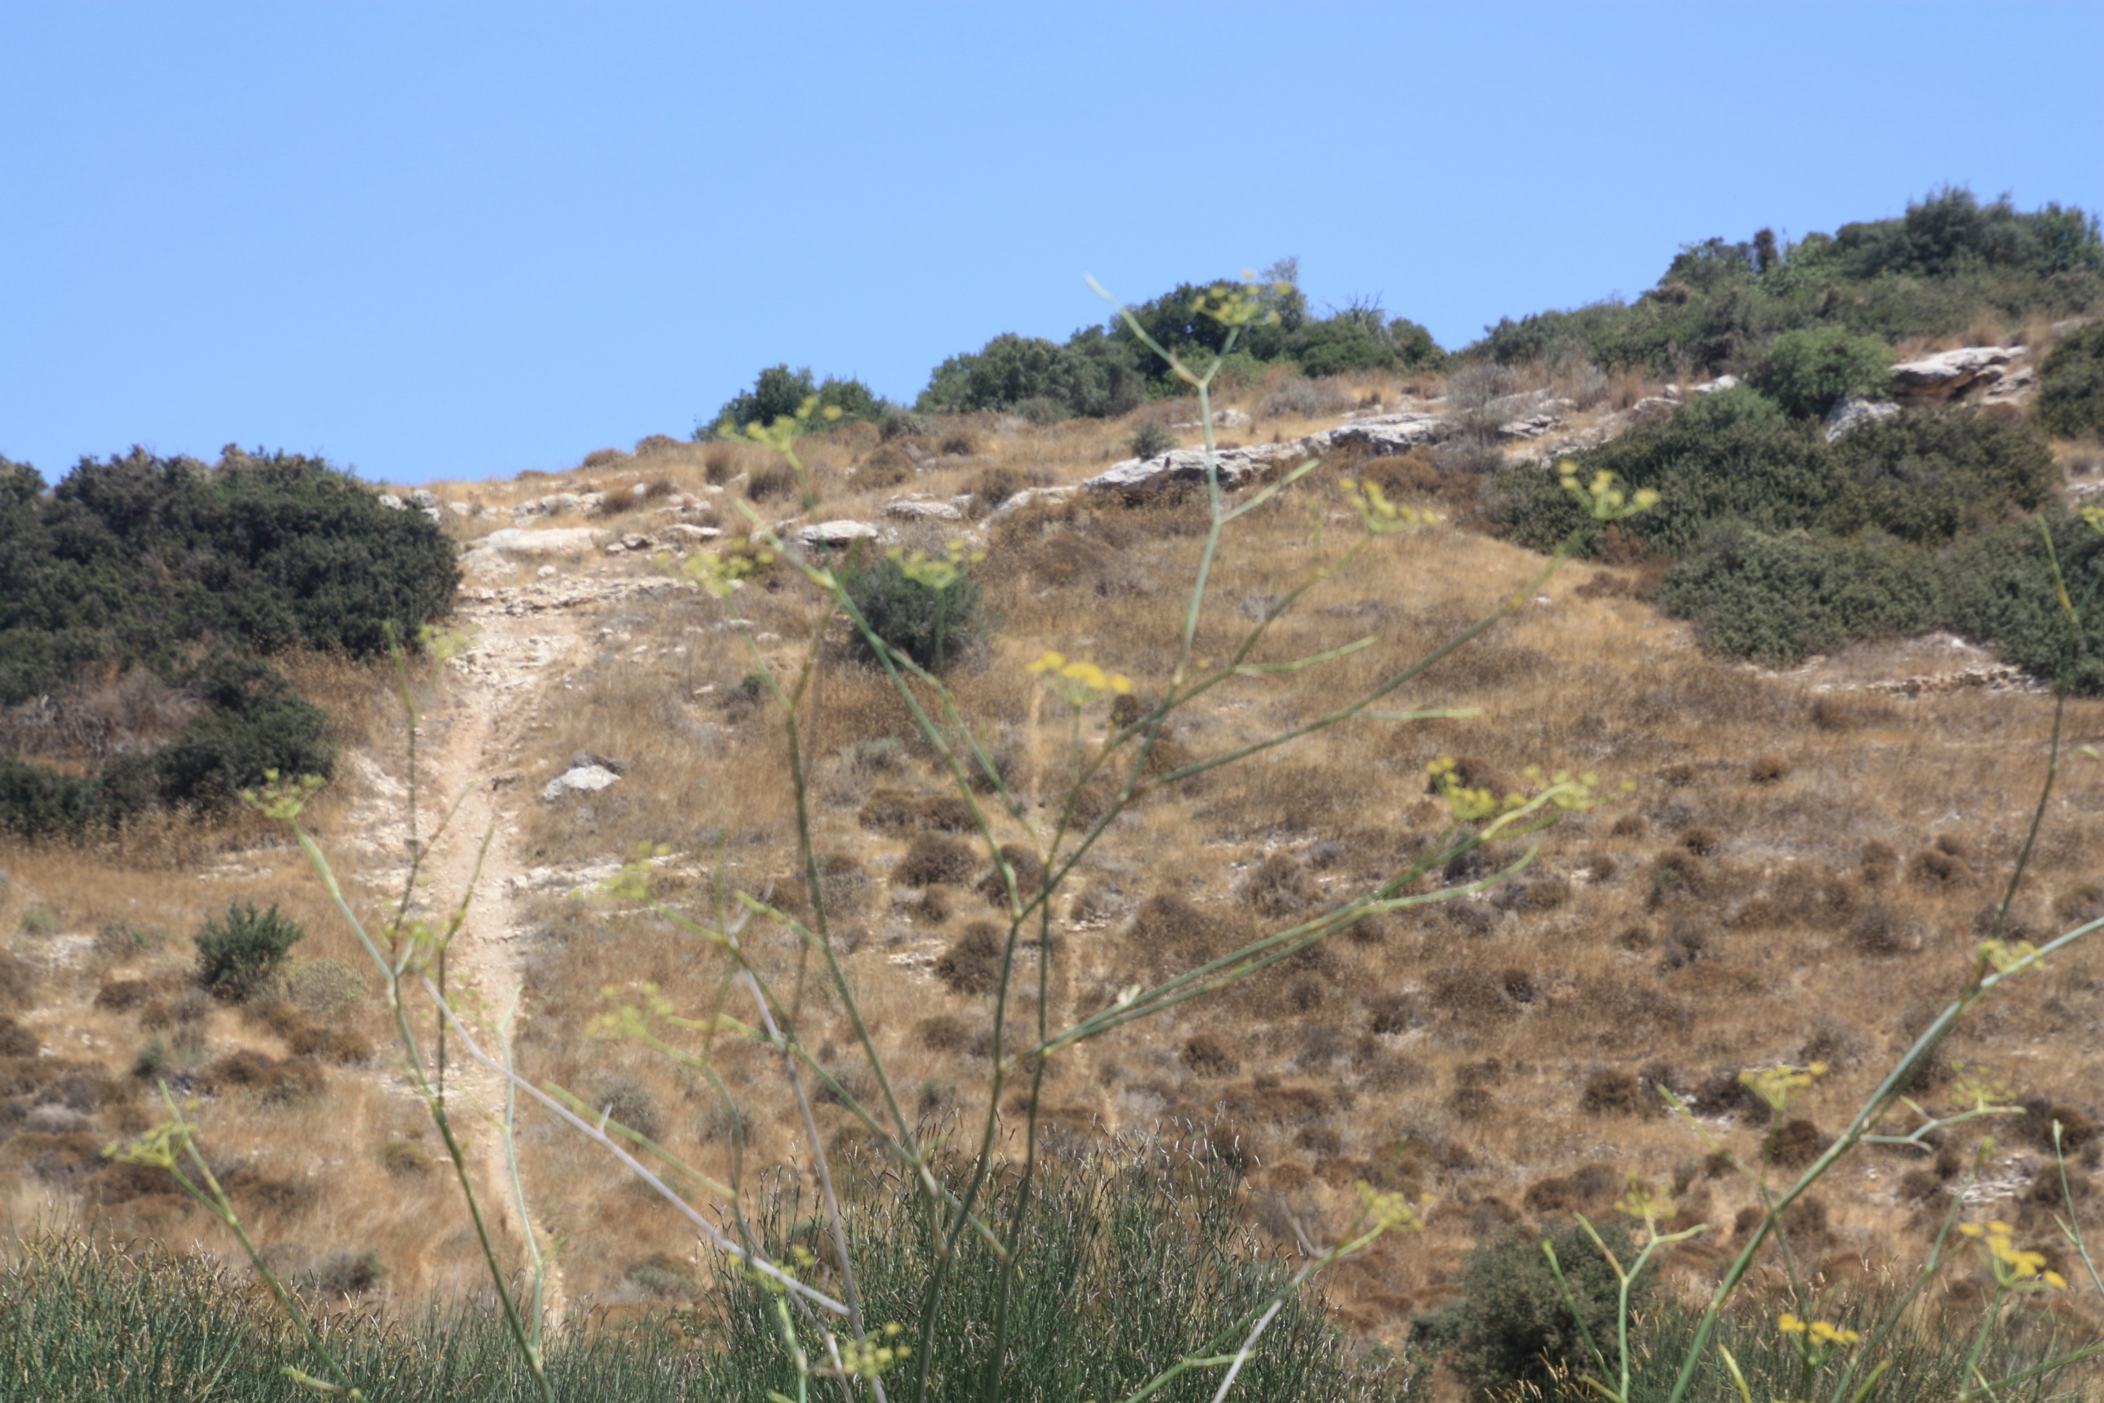
Three Remarkable Things Take Place:
1. They tell Jesus about Jesus (19)
2. They listened to Jesus in a Bible Class (27)
3. Jesus used Scripture to identify who He was (27)

Slide 6
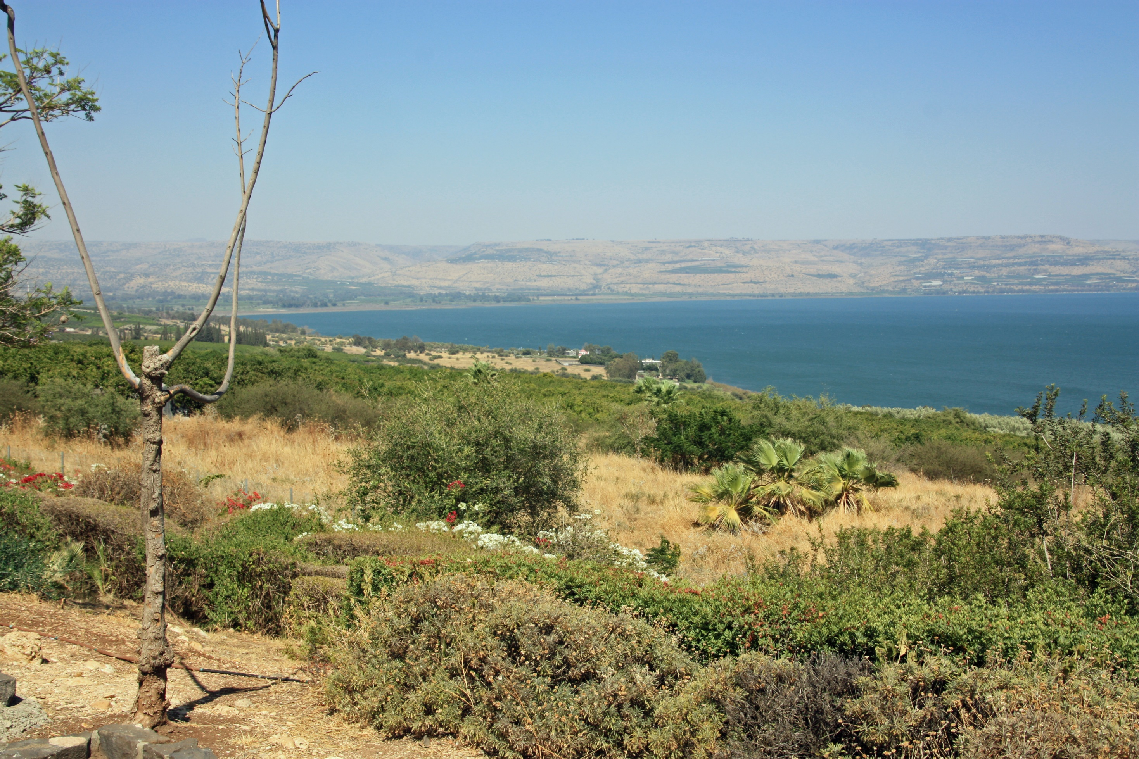
Four Pieces of Evidence
1. It was the “Third Day” (21)
John 2:19, 21 “Jesus answered and said to them, ‘Destroy this temple, and in three days I will raise it up…But He was speaking of the temple of His body.”
Matthew 16:21 “From that time Jesus Christ began to show His disciples that He must go to Jerusalem, and suffer many things from the elders and chief priests and scribes, and be killed, and be raised up on the third day.”

Slide 7
Four Pieces of Evidence
1. It was the “Third Day” (21)
2. The women amazed us (22-23)
Phillips: “disturbed us profoundly”
They went to the tomb and He was not there

Slide 8
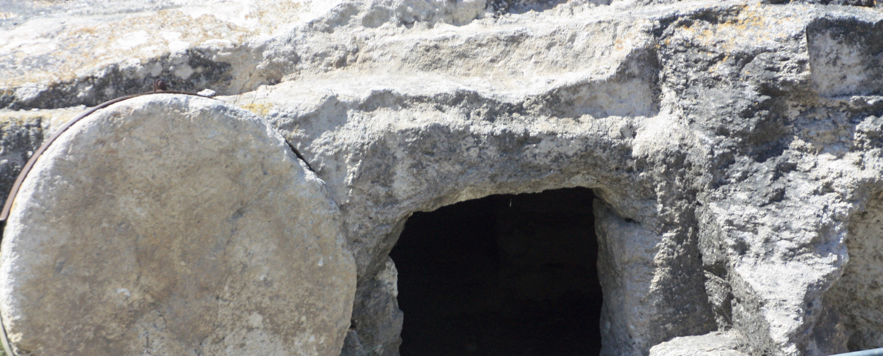
Mark 16:9-11 “Now after He had risen early on the first day of the week, He first appeared to Mary Magdalene, from whom He had cast out seven demons. She went and reported to those who had been with Him, while they were mourning and weeping. And when they heard that He was alive, and had been seen by her, they refused to believe it.”

Slide 9
Four Pieces of Evidence
1. It was the “Third Day” (21)
2. The women amazed us (22-23)
3. Others went and said it was true (24)
John 20:2-8

Slide 10
Four Pieces of Evidence
1. It was the “Third Day” (21)
2. The women amazed us (22-23)
3. Others went and said it was true (24)
4. Angels reported the same thing (23)
Matthew 28:5-6 “The angel said to the women, “Do not be afraid; for I know that you are looking for Jesus who has been crucified. He is not here, for He has risen, just as He said. Come, see the place where He was lying.”

Slide 11
Disappointed…Discouraged
Four pieces of evidence, yet they walked home sad

Slide 12
Jesus did not preform a miracle
Jesus did not show the nail prints
Jesus explained Himself through Scriptures (27)

Slide 13
Deuteronomy 18:18-19 “I will raise up a prophet from among their countrymen like you, and I will put My words in his mouth, and he shall speak to them all that I command him. It shall come about that whoever will not listen to My words which he shall speak in My name, I Myself will require it of him.
Jesus explained Himself through Scriptures (27)

Slide 14
Isaiah 7:14 “Therefore the Lord Himself will give you a sign: Behold, a virgin will be with child and bear a son, and she will call His name Immanuel.”
Jesus explained Himself through Scriptures (27)

Slide 15
Isaiah 9:6-7 “For a child will be born to us, a son will be given to us; and the government will rest on His shoulders; and His name will be called Wonderful Counselor, Mighty God, Eternal Father, Prince of Peace…on the throne of David and over his kingdom to establish it and uphold it with justice and righteousness from then on and forevermore.”
Jesus explained Himself through Scriptures (27)

Slide 16
Isaiah 53:5 “But He was pierced through for our transgressions, He was crushed for our iniquities; the chastening for our well-being fell upon Him, and by His scourging we are healed.”
Jesus explained Himself through Scriptures (27)

Slide 17
The sadness was replaced with a burning within them
Joy and excitement filled their hearts

Slide 18
It was more than facts, it was faith
It was more than details, it was life
Luke 24:33 “And they arose that very hour and returned to Jerusalem and found gathered together the eleven and those who were with them.”

Slide 19
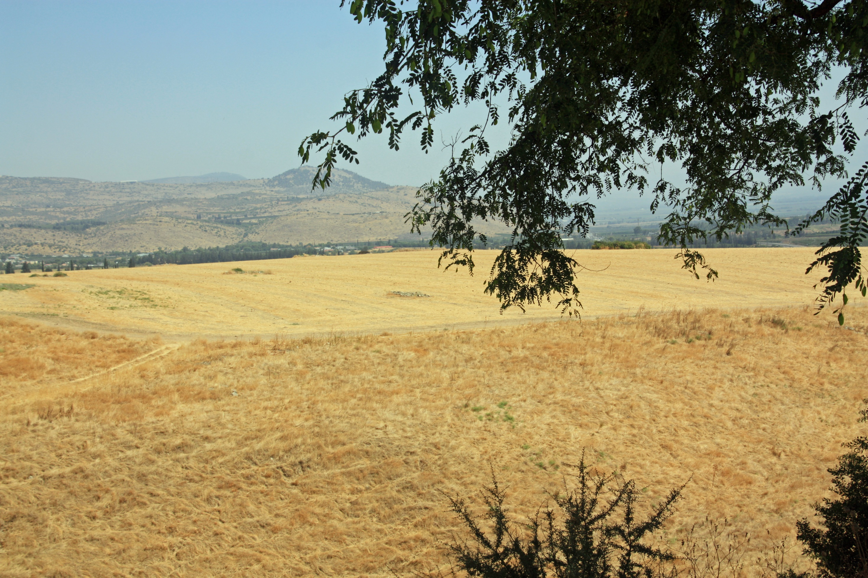
Mark 16:12-13 “And after that He appeared in a different form to two of them, while they were walking along on their way to the country. And they went away and reported it to the others, but they did not believe them either.”

Slide 20
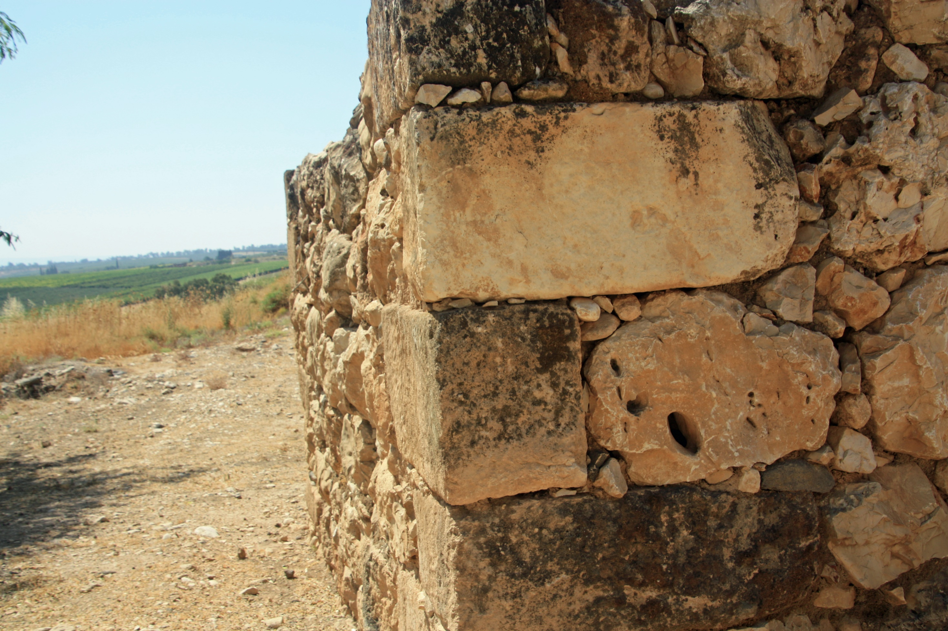
Six Foundation Stones
1. God will not give you more than you can handle
1 Corinthians 10:13 “No temptation has overtaken you but such as is common to man; and God is faithful, who will not allow you to be tempted beyond what you are able, but with the temptation will provide the way of escape also, so that you will be able to endure it.
God’s got this

Slide 21
Six Foundation Stones
2. God is with you
Psalms 23:4 “Even though I walk through the valley of the shadow of death, I fear no evil, for You are with me; Your rod and Your staff, they comfort me.”
God’s got this

Slide 22
Six Foundation Stones
3. God will forgive you
1 John 1:9 “If we confess our sins, He is faithful and righteous to forgive us our sins and to cleanse us from all unrighteousness.”
God’s got this

Slide 23
Six Foundation Stones
4. God is in our midst
Matthew 18:20 “For where two or three have gathered together in My name, I am there in their midst.”
God’s got this

Slide 24
Six Foundation Stones
5. God promises it will only get better
John 14:2-3 “In My Father’s house are many dwelling places; if it were not so, I would have told you; for I go to prepare a place for you. If I go and prepare a place for you, I will come again and receive you to Myself, that where I am, there you may be also.”
God’s got this

Slide 25
Six Foundation Stones
6. God assures that Jesus is coming
Matthew 25:31 “But when the Son of Man comes in His glory, and all the angels with Him, then He will sit on His glorious throne.”
God’s got this

Slide 26
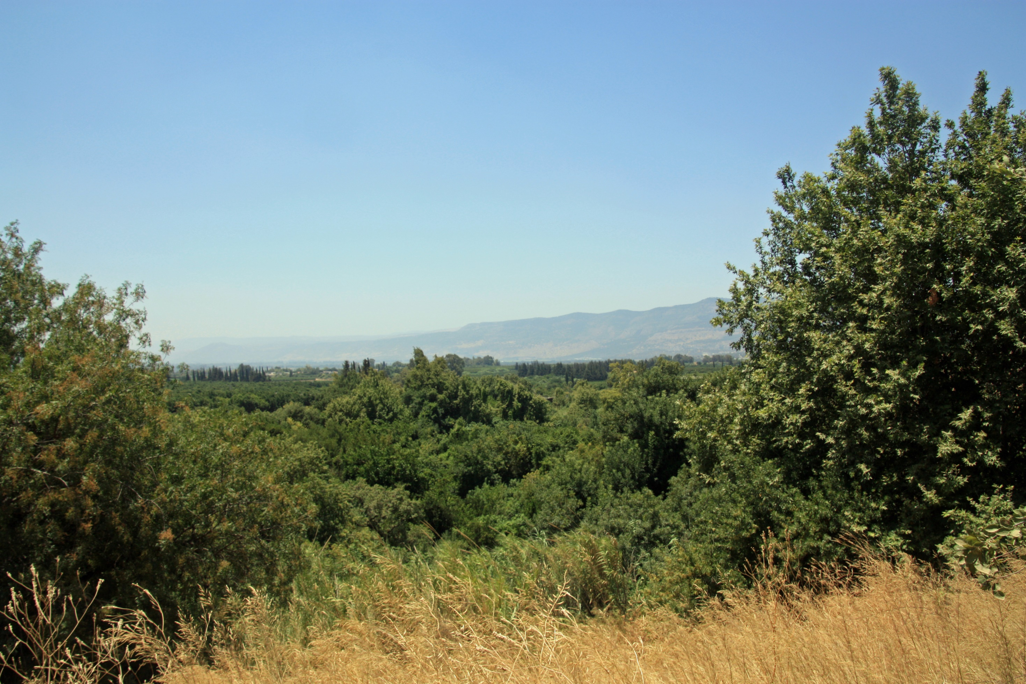
^{Luke 24:34-36} ”saying, “The Lord has really risen and has appeared to Simon.” They began to relate their experiences on the road and how He was recognized by them in the breaking of the bread. While they were telling these things, He Himself stood in their midst and said to them, “Peace be to you.”

Slide 27
The Journey from Knowing to Believing
Luke 24:13-33

